Slide 1


Developing SMS Spam Filter
Submitted by:
D22033 – Poojitha Gujjula
This Photo by Unknown author is licensed under CC BY-NC.

Slide 2
DATA PRE-PREPROCESSING
Raw data
Removed stopwords
Removed white spaces
Lemmatization

Slide 3


DATA EXPLORATION
Word cloud for HAM
Word cloud, which represents most common words in a space, with the size of each word proportional to the frequency of its occurrence.
Most frequently repeating HAM words are go , u, come, time , know, good etc.
Most frequently repeating SPAM words are call, free, txt, stop, text, mobile, claim, reply, send etc.
Word cloud for SPAM

Slide 4
VECTORIZATION
Vectorization is jargon for a classic approach of converting input data from its raw format (i.e. text ) into vectors of real numbers which is the format that ML models support.
1) Vectorization using Term Frequency
Converting the document- term matrix to a dataframe
Count vectorizer
Vectorized our input
Using TF

Slide 5
2)Vectorization using Term Frequency-Inverse Document Frequency
Converting the document- term matrix to a dataframe
Initializing the data
Vectorized our input
Using TF-IDF
3)Doc-to-Vec model using Google’s Word-to-Vec model
Created a Data Frame with those Vectors
Used Google's Pre-trained model
Converted each document into a vector of 300 size

Slide 6
DIMENSION REDUCTION
PCA (Principal Component Analysis) is a dimensionality reduction technique
The goal of PCA is to find a smaller set of variables that captures the maximum amount of variance in the original data set.
Determined the cumulative percentage of the variance explained by the principal components
Determined the number of principal components that explains the 95% of variance
Created Data Frame with principal components

Slide 7
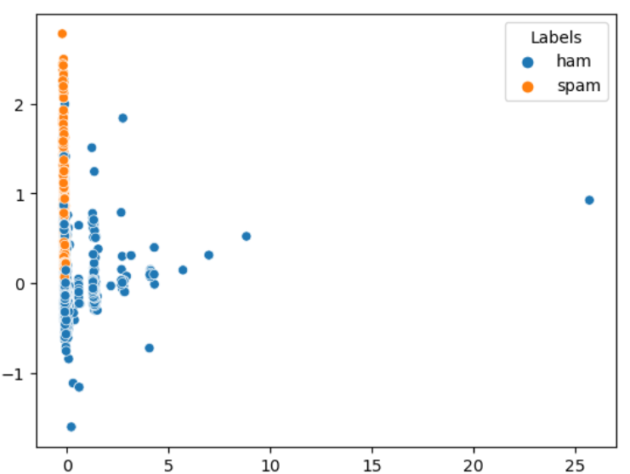
Used PCA (Principal Component Analysis) on TF Vectors. Choose the first 2 components which showed maximum variance to plot the graph. Columns before – 7983 Columns after - 200
1)PCA on TF

Slide 8
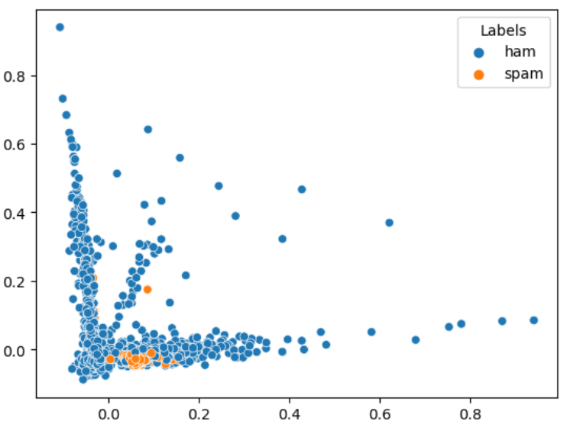
PCA on TF-IDF
Performed PCA on TF-IDF vectors ,chose the first 2 components which showed maximum variance to plot the graph. Columns before – 7983 Columns after - 5574

Slide 9
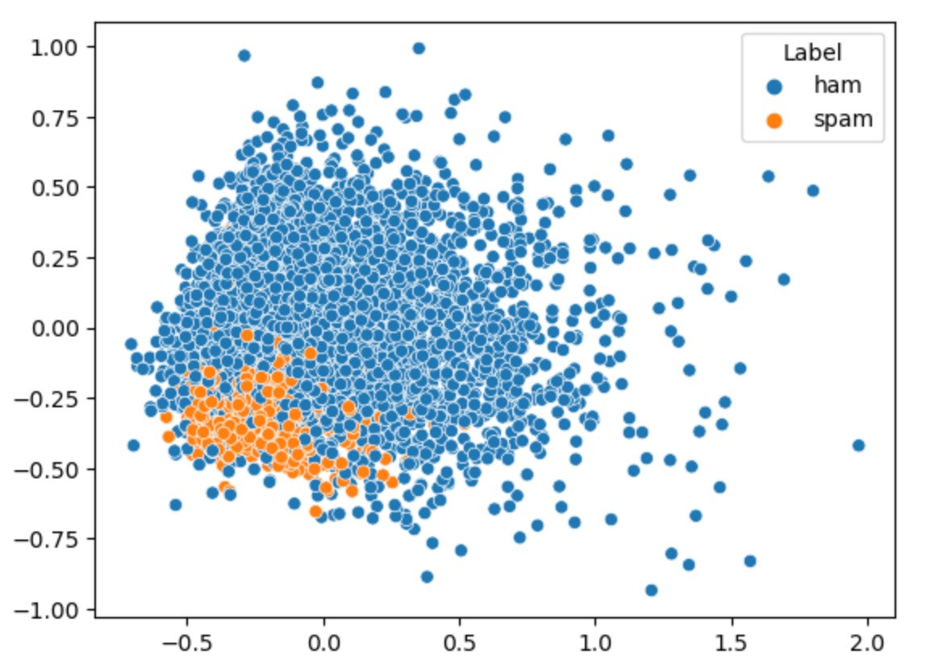
PCA on word to vec
Performed PCA on word to vec vectors ,chose the first 2 components which showed maximum variance to plot the graph. Columns before – 300 Columns after - 180
2.Heuristic approach:
The dimension reduction is done by dropping texts that appear in less than 1% of the document(rare words).

Slide 10
MODEL CLASSIFICATION
MODEL 1 : DECISION TREE ON Term Frequency (With PCA)
OBSERVATIONS
Aim – Classifying Spam and ham messages
Experiment – Used tuned decision tree classifier on Term Frequency (with PCA reduction)
TEST METRICS
Accuracy Score | 90%
F1 score | 94%
Recall Score | 95%
Precision Score | 94%

Slide 11
MODEL 2 : RANDOM FOREST ON Term Frequency (With PCA)
OBSERVATIONS
Aim – Classifying Spam and ham messages
Experiment – Used random forest on Term Frequency (with PCA reduction)
TEST METRICS
Accuracy Score | 96%
F1 Score | 98%
Recall Score | 99%
Precision Score | 96%

Slide 12
MODEL 3 : BAGGING CLASSIFIER ON Term Frequency (With PCA)
OBSERVATIONS
Aim – Classifying Spam and ham messages
Experiment – Used bagging classifier on Term Frequency (with PCA reduction)
TEST METRICS
Accuracy Score | 95%
F1 Score | 97%
Recall Score | 97%
Precision Score | 97%

Slide 13
MODEL 4 : DECISION TREE ON TF-IDF (With PCA)
OBSERVATIONS
Aim – Classifying Spam and ham messages
Experiment – Used tuned decision tree classifier on TF-IDF (with PCA reduction)
TEST METRICS
Accuracy Score | 93%
F1 Score | 95%
Recall Score | 94%
Precision Score | 97%

Slide 14
MODEL 5 : DECISION TREE ON word to vec (With PCA)
OBSERVATIONS
Aim – Classifying Spam and ham messages
Experiment – Used tuned decision tree classifier on word to vec (with PCA reduction)
TEST METRICS
Accuracy Score | 89%
F1 Score | 94%
Recall Score | 95%
Precision Score | 93%

Slide 15
MODEL 6 : ADAPTIVE BOOSTING ON word to vec (With PCA)
OBSERVATIONS
Aim – Classifying Spam and ham messages
Experiment – Used adaptive boosting on word to vec (with PCA reduction)
TEST METRICS
Accuracy Score | 90%
F1 Score | 94%
Recall Score | 96%
Precision Score | 92%

Slide 16
MODEL 7: RANDOM FOREST ON TF(With P%)
OBSERVATIONS
Aim – Classifying Spam and ham messages
Experiment – Used random forest on TF(with P%)
TEST METRICS
Accuracy Score | 96%
F1 Score | 98%
Recall Score | 98%
Precision Score | 97%

Slide 17
MODEL 8 : BAGGING CLASSIFIER ON TF(With P%)
OBSERVATIONS
Aim – Classifying Spam and ham messages
Experiment – Used bagging classifier on TF (with P% reduction)
TEST METRICS
Accuracy Score | 95%
F1 Score | 97%
Recall Score | 96%
Precision Score | 97%

Slide 18
MODEL 9 : DECISION TREE ON TF-IDF (With P%)
OBSERVATIONS
Aim – Classifying Spam and ham messages
Experiment – Used tuned decision tree classifier on TF-IDF(with P% reduction)
TEST METRICS
Accuracy Score | 90%
F1 Score | 94%
Recall Score | 95%
Precision Score | 93%

Slide 19
MODEL 10: RANDOM FOREST ON TF-IDF(With P%)
OBSERVATIONS
Aim – Classifying Spam and ham messages
Experiment – Used random forest on TF-IDF(with P%)
TEST METRICS
Accuracy Score | 90%
F1 Score | 94%
Recall Score | 96%
Precision Score | 93%

Slide 20
MODEL 11: ADAPTIVE BOOSTING ON TF-IDF(With P%)
OBSERVATIONS
Aim – Classifying Spam and ham messages
Experiment – Used adaptive boosting on TF-IDF(with P% reduction)
TEST METRICS
Accuracy Score | 90%
F1 Score | 94%
Recall Score | 96%
Precision Score | 92%

Slide 21
MODEL 12 : BAGGING CLASSIFIER ON TF-IDF(With P%)
OBSERVATIONS
Aim – Classifying Spam and ham messages
Experiment – Used bagging classifier on TF-IDF (with P% reduction)
TEST METRICS
Accuracy Score | 90%
F1 Score | 94%
Recall Score | 95%
Precision Score | 93%

Slide 22
CONCLUSION :
From the above results, models that used in term frequency vectorization gave better results when compared to TF-IDF .
Models that tuned with Word to vectorization gave poor results
Over all random forest classifier tuned with term frequency gave better result
This final model gave F1 –score of 98%
Hence our model is able to predict spam messages efficiently

